Slide 1

DataONE: A Data Federation with Provenance Support
Yang Cao¹, Christopher Jones², Víctor Cuevas-Vicenttín³,
Matthew B. Jones², Bertram Ludäscher¹, Timothy McPhillips¹,
Paolo Missier⁴, Christopher Schwalm⁵, Peter Slaughter²,
Dave Vieglais⁶, Lauren Walker², Yaxing Wei⁷
¹University of Illinois, Urbana-Champaign,
²National Center for Ecological Analysis and Synthesis, UCSB,
³Universidad Popular Autónoma del Estado de Puebla, Mexico,
⁴School of Computing Science, Newcastle University, UK,
⁵Woods Hole Research Center, Falmouth, MA,
⁶University of Kansas, Lawrence,
⁷Environmental Sciences Division, Oak Ridge National Lab, TN

Slide 2


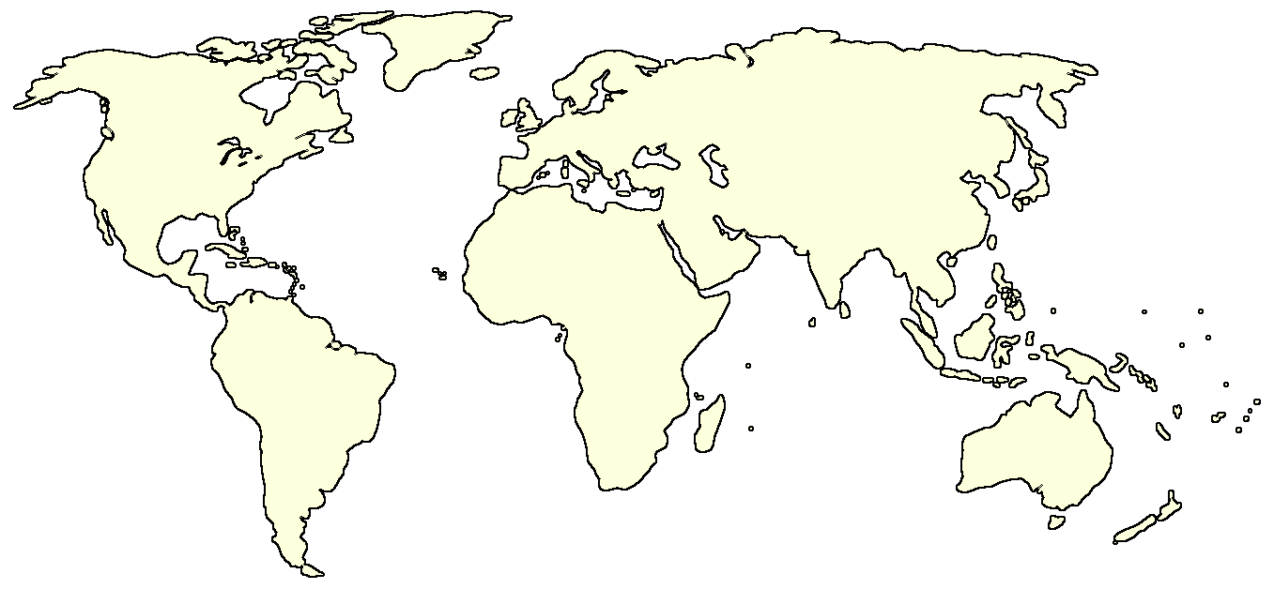

















What is DataONE? Coordinating Nodes, Member Nodes
Components for a flexible, scalable, sustainable network
Coordinating Nodes
retain complete metadata catalog
indexing for search
network-wide services
ensure content availability (preservation)
replication services
Member Nodes
diverse institutions
serve local community
provide resources for managing their data
retain copies of data
www.dataone.org/member-nodes
Notes:
Member nodes are the repositories that have the actual data.

Slide 3

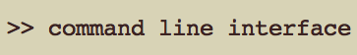







What is DataONE? Investigator Toolkit
Components for a flexible, scalable, sustainable network
Coordinating Nodes
retain complete metadata catalog
indexing for search
network-wide services
ensure content availability (preservation)
replication services
Member Nodes
diverse institutions
serve local community
provide resources for managing their data
retain copies of data
Investigator Toolkit
YW
www.dataone.org/investigator-toolkit
Notes:
Scientists can use the toolkits to create and share their studies or experimental data. Eg, R or Matlab

Slide 4
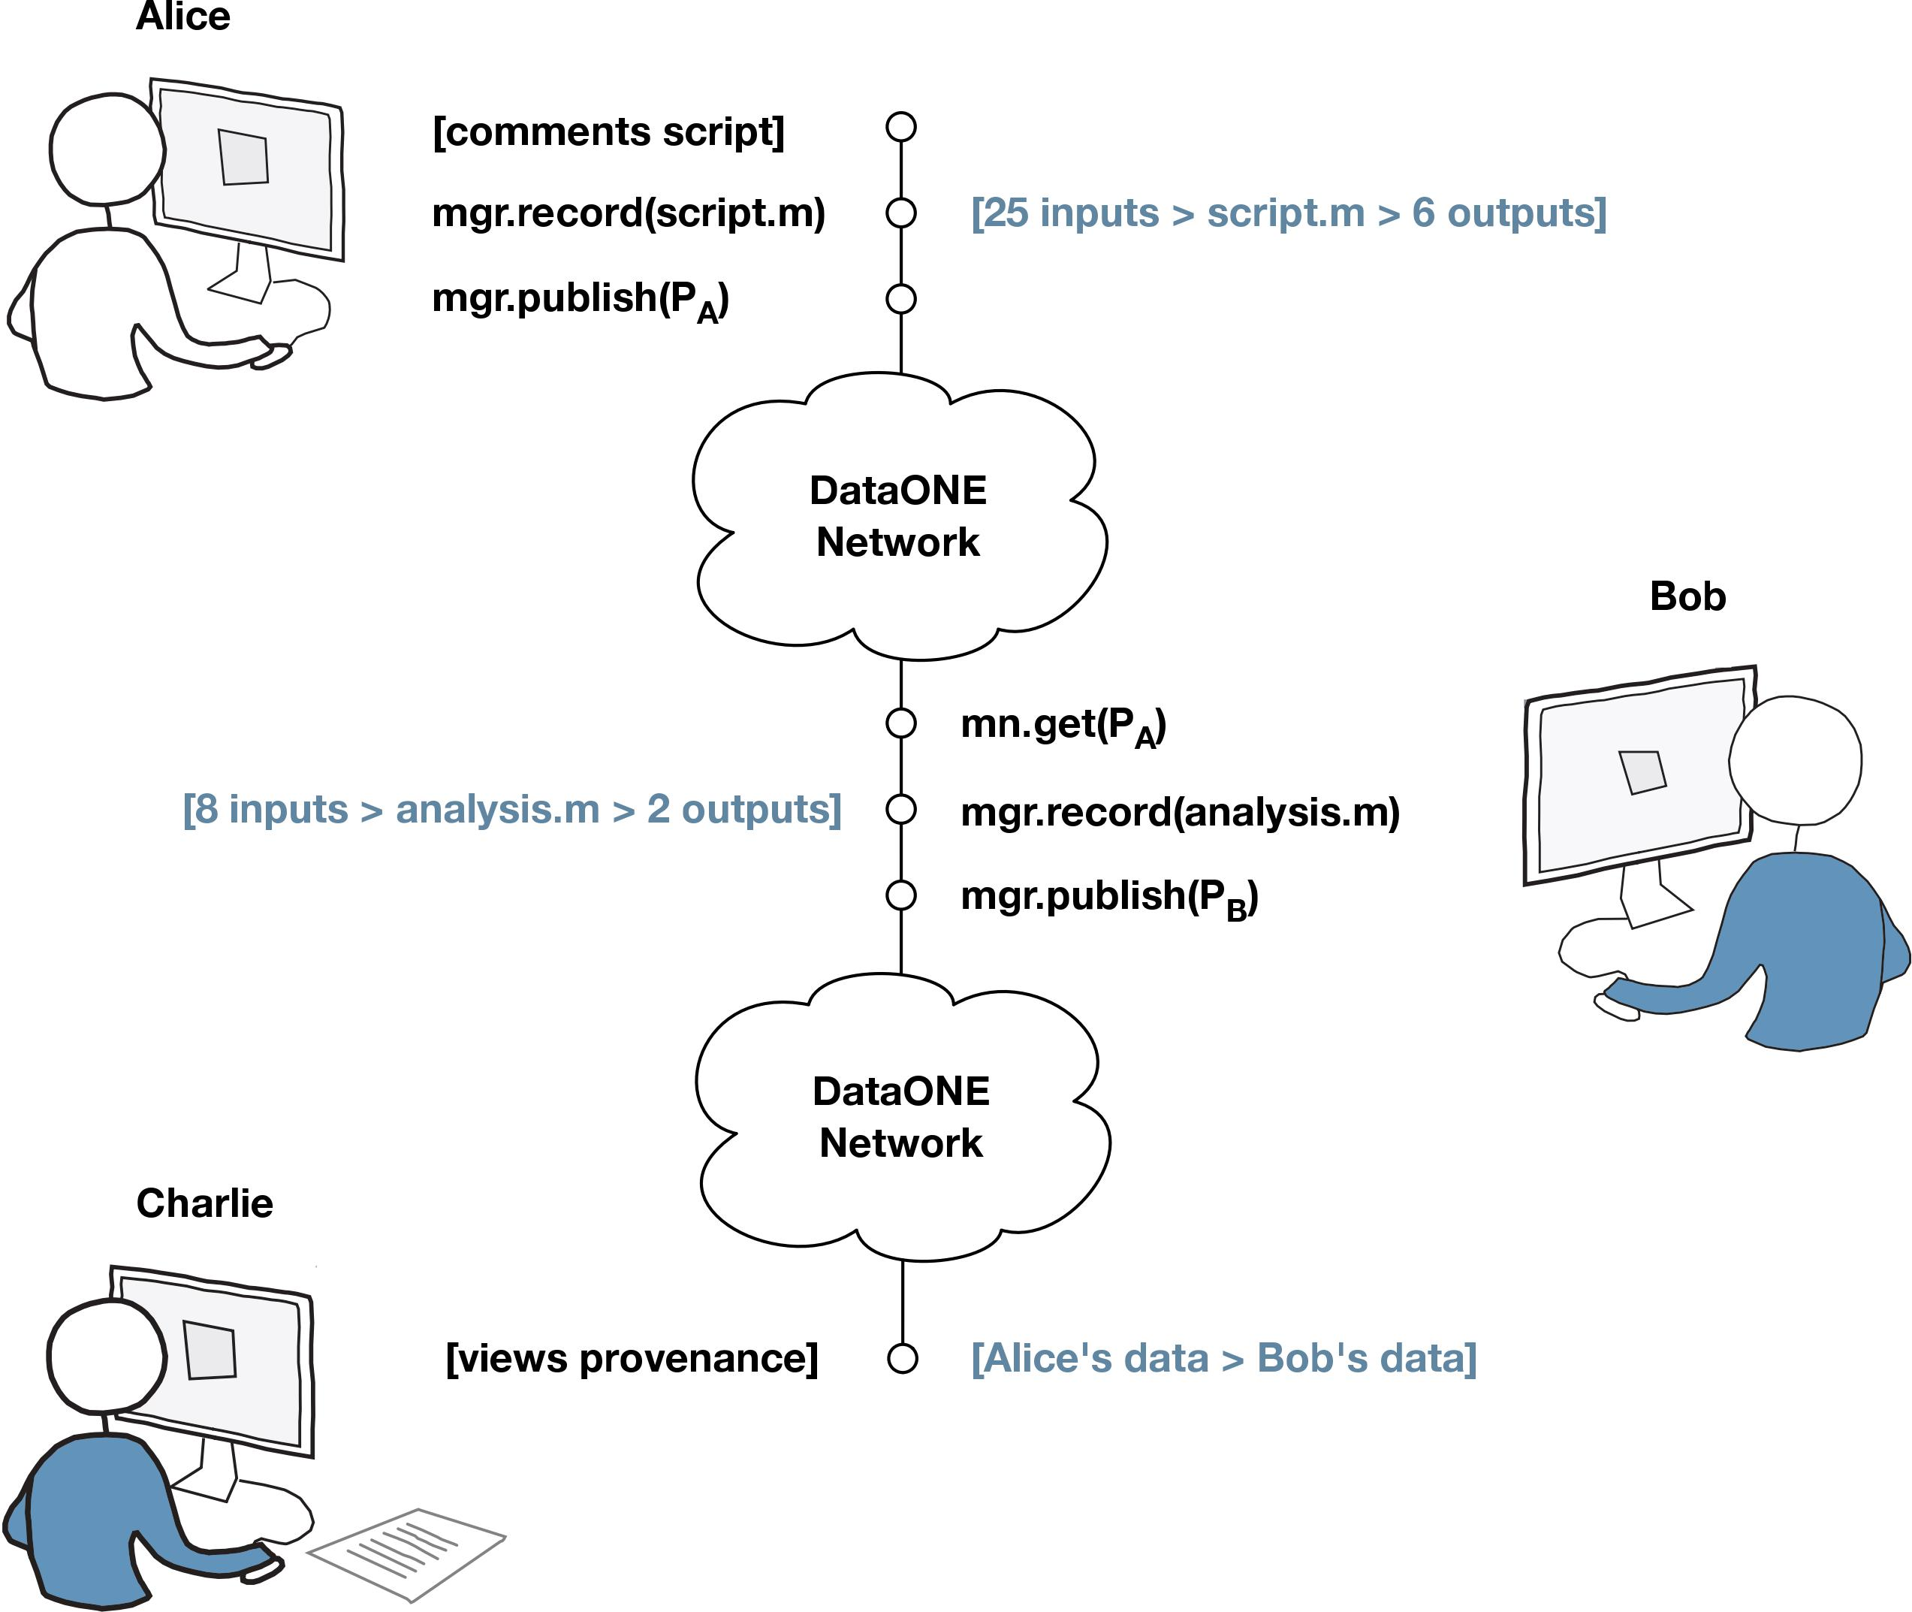
Provenance Use Case
Alice
Run Managers
(provenance capture)
Bob
Charlie
Notes:
1. Alice runs a MATLAB script with “provenance capture ON”.
2. She uploads a run to DataONE (data, script, prospective and retrospective provenance).
3. Bob discovers Alice’s data with provenance.
4. When Bob shares his results ..
5. … Charlie can see the provenance trail

Slide 5
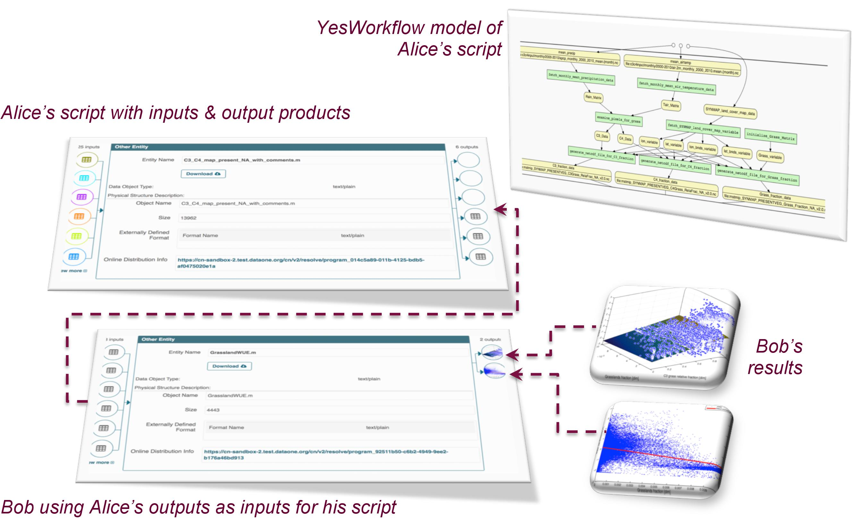
Provenance Use Case
Notes:
1. Alice runs a MATLAB script with “provenance capture ON”.
2. She uploads a run to DataONE (data, script, prospective and retrospective provenance).
3. Bob discovers Alice’s data with provenance.
4. When Bob shares his results ..
5. … Charlie can see the provenance trail

Slide 6
Additional Material
(not part of the lightning talk, but additional material to be shown at the poster session, if needed)

